Slide 1


Bi-directional associative memory and architecture
=============================================================================
WWW.THEMLLABS.COM || contact@themllabs.com || Phone : 91-7338339898, 91-6362546088

Slide 2
Agenda
Bidirectional associative memory
BAM architecture
BAM algorithm
BAM limitations
=============================================================================
WWW.THEMLLABS.COM || contact@themllabs.com || Phone : 91-7338339898, 91-6362546088

Slide 3
Bidirectional associative memory
Bidirectional associative memory(BAM) is a supervised learning model in ANN.
This memory is hetero associative memory for any input and produce different pattern which is of different size.
The phenomenon is similar to the human brain.
=============================================================================
WWW.THEMLLABS.COM || contact@themllabs.com || Phone : 91-7338339898, 91-6362546088

Slide 4
It uses chain of mental associations to recover a lost memory (ex. Association of questions with answer, faces with names etc.).
BAM’s important use is to store hetero associative pattern pairs.
It is also used to retrieve pattern from noisy or incomplete pattern.
=============================================================================
WWW.THEMLLABS.COM || contact@themllabs.com || Phone : 91-7338339898, 91-6362546088

Slide 5
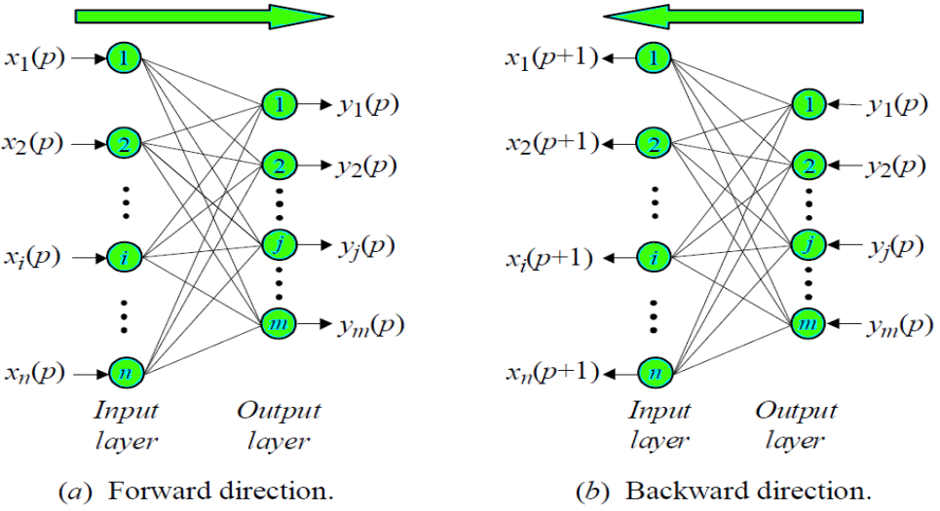
BAM architecture
=============================================================================
WWW.THEMLLABS.COM || contact@themllabs.com || Phone : 91-7338339898, 91-6362546088

Slide 6
If BAM accepts m-directional vector X from set a then it recalls n-dimensional vector Y from set b.
Similarly if BAM accepts vectors from b then it recalls the vectors from set a.
=============================================================================
WWW.THEMLLABS.COM || contact@themllabs.com || Phone : 91-7338339898, 91-6362546088

Slide 7

BAM algorithm
In the learning step of BAM algorithm, weight matrix is calculated between M pairs of patterns (fundamental memories) are stored in the synaptic weights of the network.
The following equation is given below:
=============================================================================
WWW.THEMLLABS.COM || contact@themllabs.com || Phone : 91-7338339898, 91-6362546088

Slide 8

In Testing step, we will check BAM algorithm recalls Y_{m} correctly corresponding to X_{m}, similarly recalls X_{m} correctly corresponding to Y_{m.} Using the equation:
All pairs should be recalled accordingly.
=============================================================================
WWW.THEMLLABS.COM || contact@themllabs.com || Phone : 91-7338339898, 91-6362546088

Slide 9
For an unknown vector X (incomplete version of pattern from set A or B) to the BAM, and retrieve a previously stored association. Steps are:
Initialize the BAM,
Calculate the BAM output at iteration p,
=============================================================================
WWW.THEMLLABS.COM || contact@themllabs.com || Phone : 91-7338339898, 91-6362546088

Slide 10
Update the input vector X(p),
Repeat the iteration until it converges. i.e. when input and output remains unchanged.
=============================================================================
WWW.THEMLLABS.COM || contact@themllabs.com || Phone : 91-7338339898, 91-6362546088

Slide 11
BAM limitations
In BAM, the stored number of associations should not exceed the number of neurons in the small layer.
BAM will not produce closest association always or incorrect convergence.
=============================================================================
WWW.THEMLLABS.COM || contact@themllabs.com || Phone : 91-7338339898, 91-6362546088

Slide 12
Thank you
=============================================================================
WWW.THEMLLABS.COM || contact@themllabs.com || Phone : 91-7338339898, 91-6362546088

